Slide 1
JS
FS dev 101
Call , bind & Apply in JavaScript

Slide 2
Call , Apply Bind
call() and apply() were introduced in ECMAScript 3
While bind() was added as part of ECMAScript 5

Slide 3
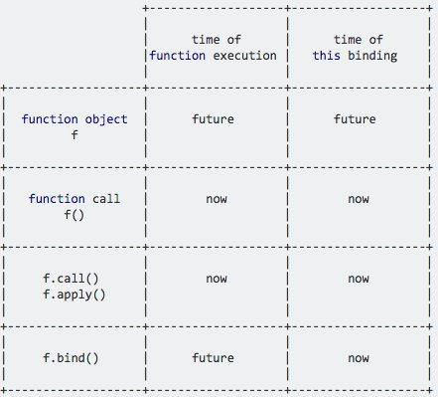

Slide 4
this
const person = {
firstName: 'John',
lastName: 'Doe',
printName: function() {
console.log(this.firstName + ' ' + this.lastName);
}
};
var printFullName = person.printName;
printFullName();
person.printName();
John Doe
undefined undefined

Slide 5
const john = {
name: 'John',
age: 24,
};
function greeting() {
console.log(`Hi, I am ${this.name} and I am ${this.age} years old`);
}
const greetingJohn = greeting.bind(john);// Hi, I am John and I am 24 years old
greetingJohn();

